Slide 1

CSE 460: VLSI Design (Lab)
Experiment 3 Part 2:
Sequential Circuits Real-life Projects
Vending Machine
Courtesy: Kaushik Biswas (EEE, BUET)

Slide 2
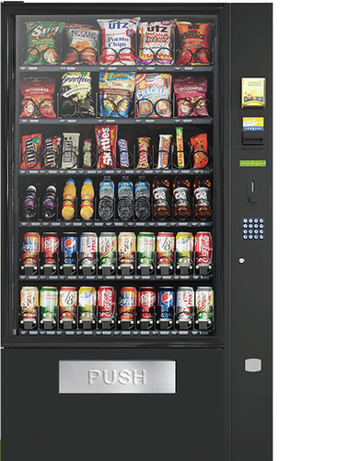
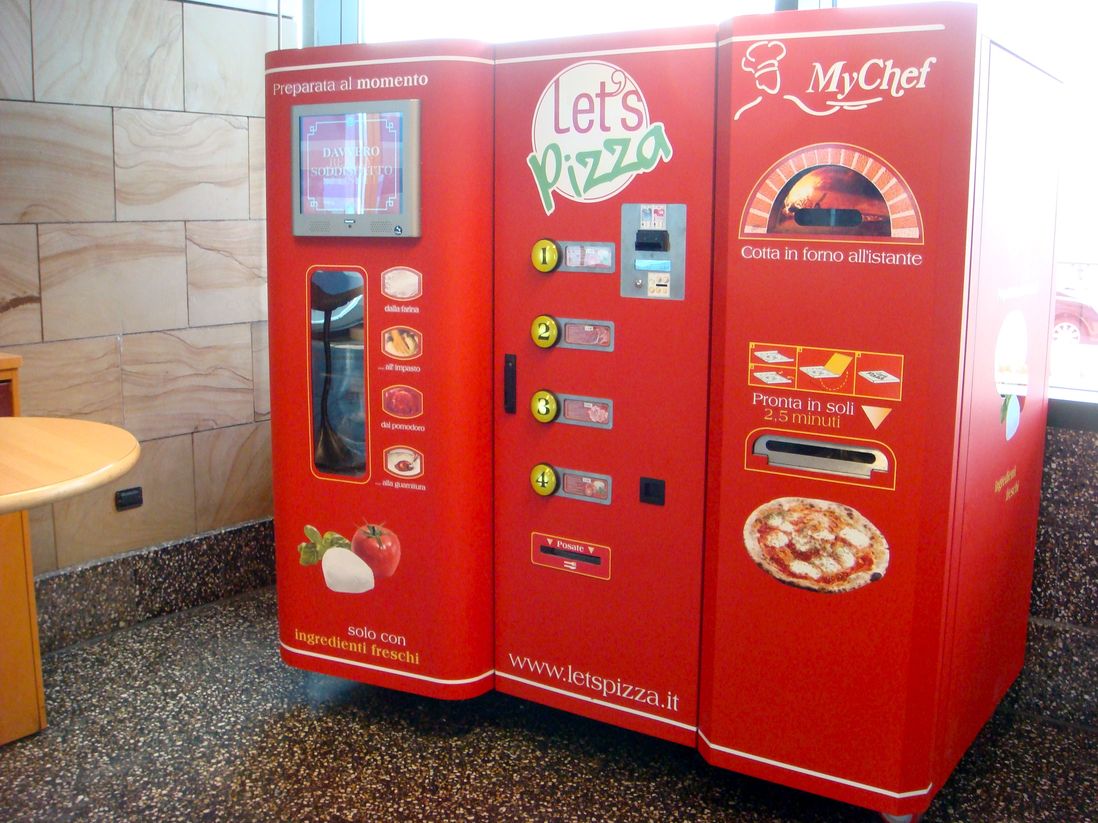

What is Vending Machine?

Slide 3


What is Vending Machine?

Slide 4
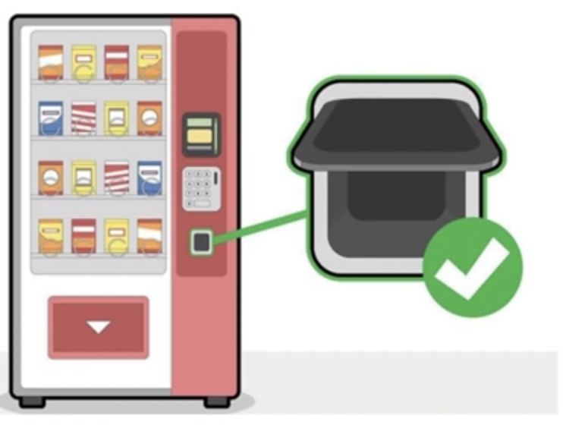
What is Vending Machine?

Slide 5
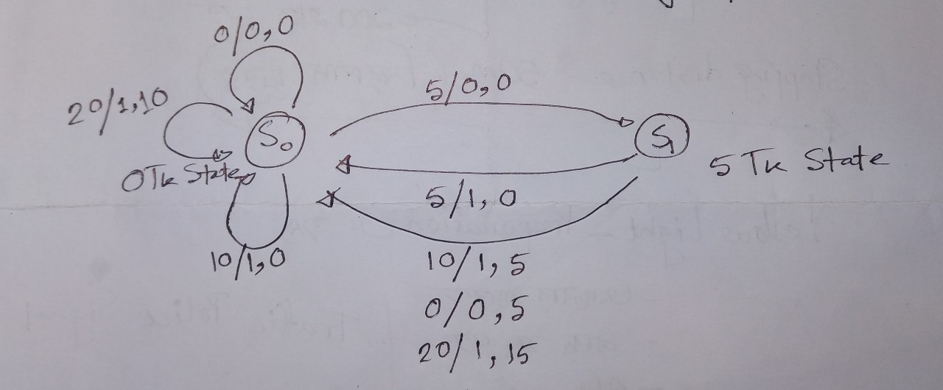
10 Tk Product Case (State Diagram)
Money in/Purchase, Change
State Diagram

Slide 6
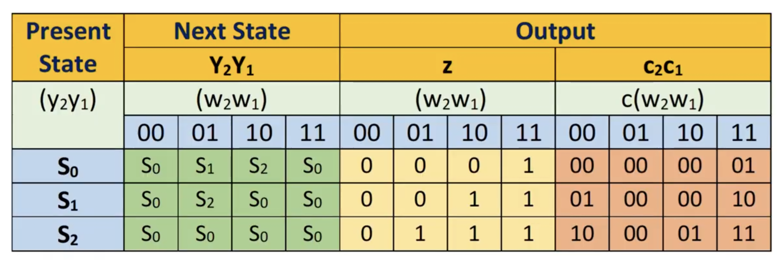
10 Tk Product Case (State Table)
S0 | S0 | S1 | S0 | S0 | 0 | 0 | 1 | 1 | 00 | 00 | 00 | 10
S1 | S0 | S0 | S0 | S0 | 0 | 1 | 1 | 1 | 01 | 00 | 01 | 11
State Table
State Diagram

Slide 7
10 Tk Product Case (State Assigned Table)
S0 | S0 | S1 | S0 | S0 | 0 | 0 | 1 | 1 | 00 | 00 | 00 | 10
S1 | S0 | S0 | S0 | S0 | 0 | 1 | 1 | 1 | 01 | 00 | 01 | 11
00 | 00 | 01 | 00 | 00 | 0 | 0 | 1 | 1 | 00 | 00 | 00 | 10
01 | 00 | 00 | 00 | 00 | 0 | 1 | 1 | 1 | 01 | 00 | 01 | 11
State Table
State Assigned Table

Slide 8
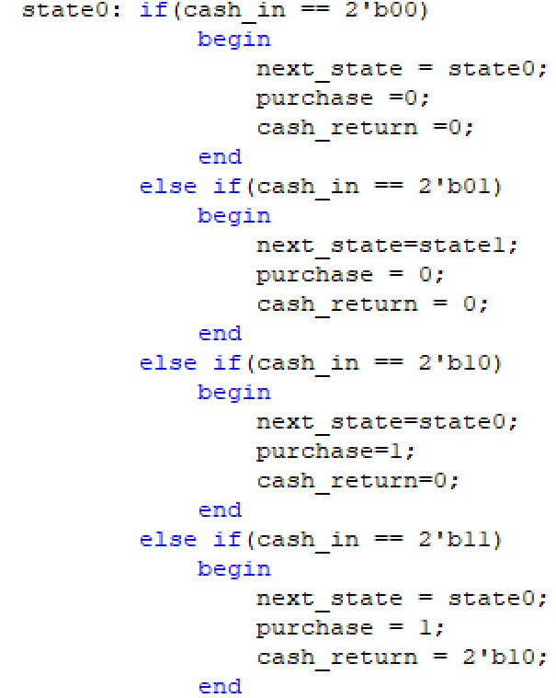
10 Tk Product Case (Code Snippet)
00 | 00 | 01 | 00 | 00 | 0 | 0 | 1 | 1 | 00 | 00 | 00 | 10
01 | 00 | 00 | 00 | 00 | 0 | 1 | 1 | 1 | 01 | 00 | 01 | 11
State Assigned Table

Slide 9
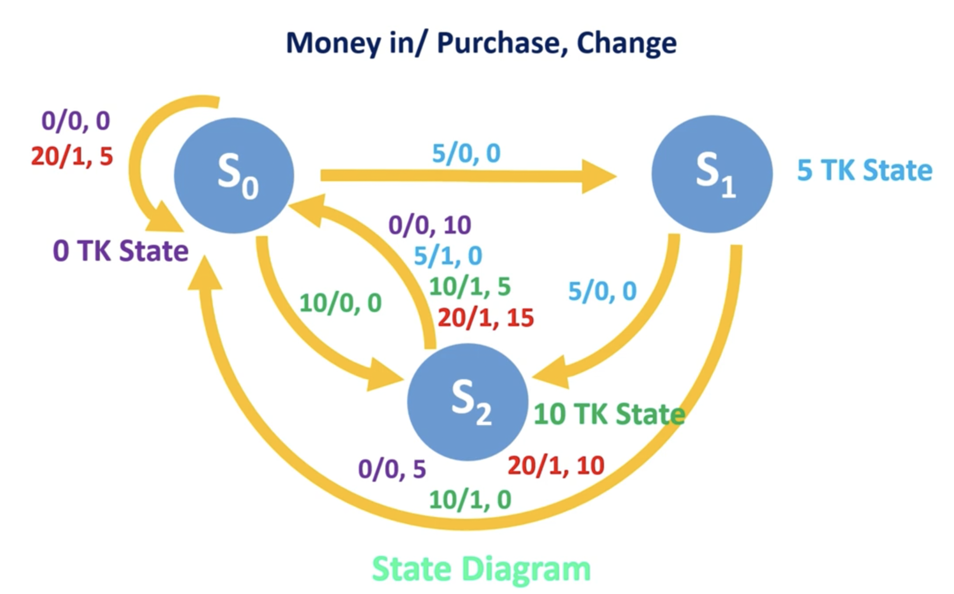
15 Tk Product Case (State Diagram)

Slide 10
15 Tk Product Case (State Table)
State Table

Slide 11
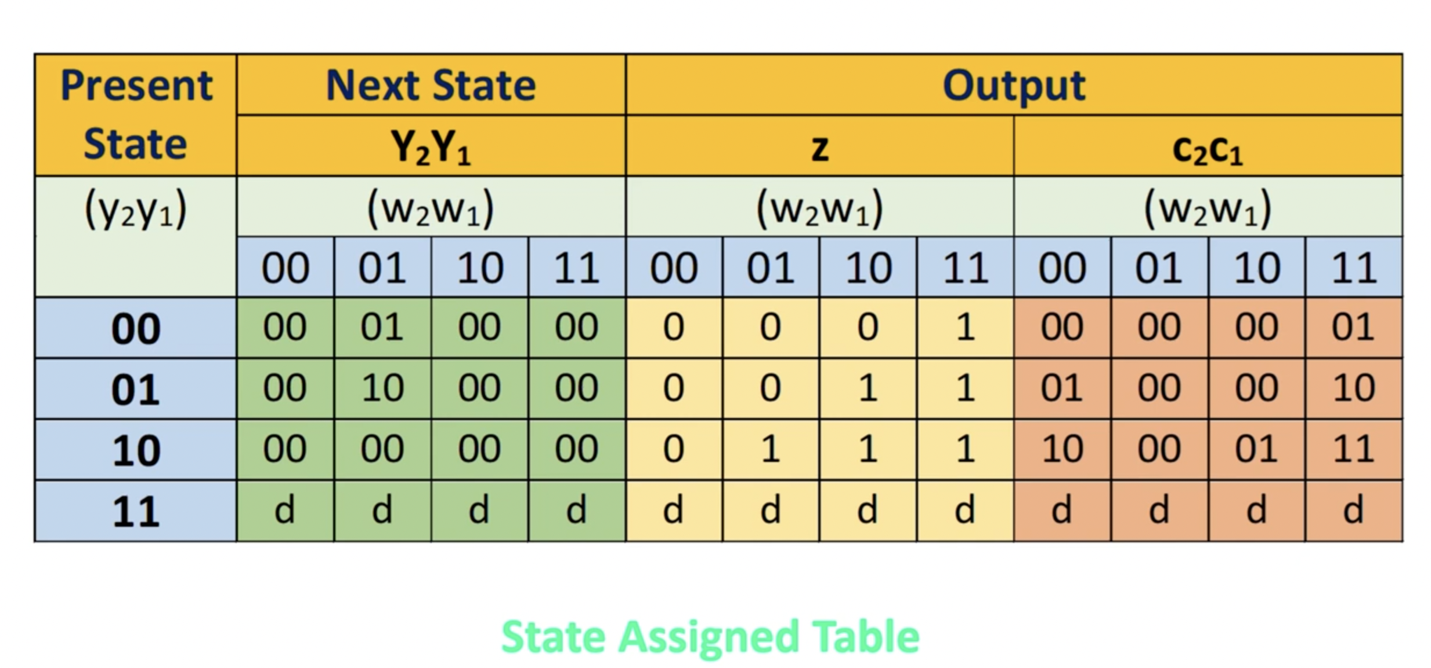
15 Tk Product Case (State Assigned Table)
10
State Table

Slide 12
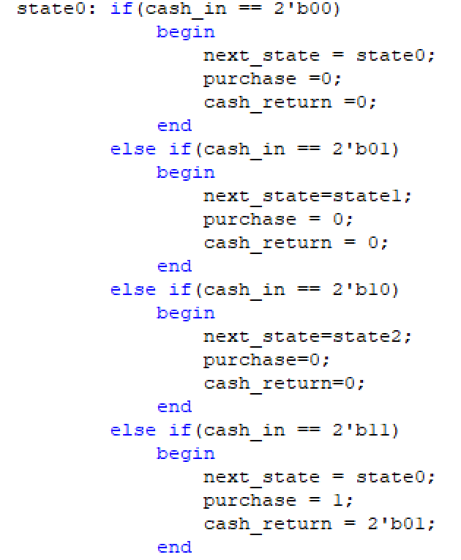
15 Tk Product Case (Code Snippet)
10

Slide 13
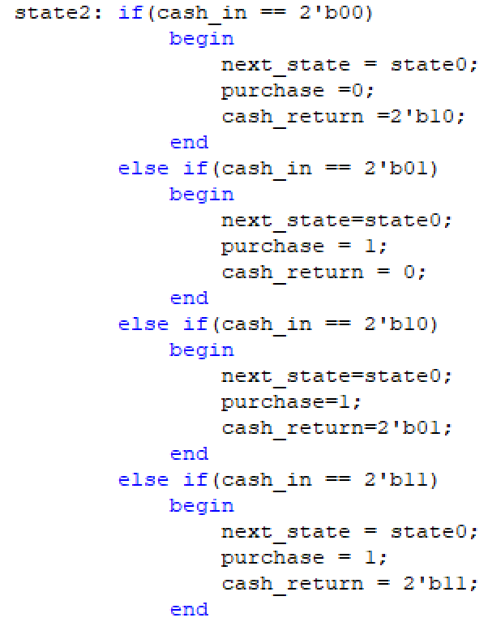
15 Tk Product Case (Code Snippet)
10

Slide 14
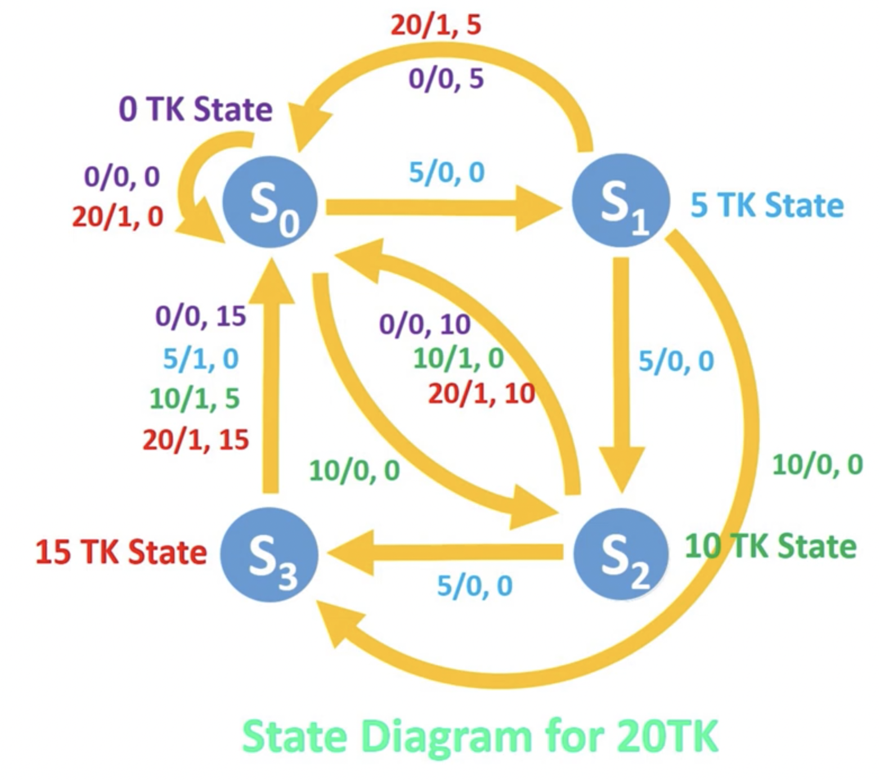
20 Tk Product Case (State Diagram)

